Slide 1

SPATIAL DATABASE PROJECT
GENERAL TRANSPORTATION SERVICES ANALYSIS

Slide 2
ANALYSIS OF BUS SERVICES IN IRELAND
Aimed to analyse the bus services across Ireland for enhanced understanding and insights.
Objectives:
Evaluate Bus Stop Distribution
Route Frequency Analysis
Bus Stop Density
Geospatial Relationships

Slide 3



DATA PREPARATION
Exported the layer as PostgreSQL Dump SQL file

Slide 4
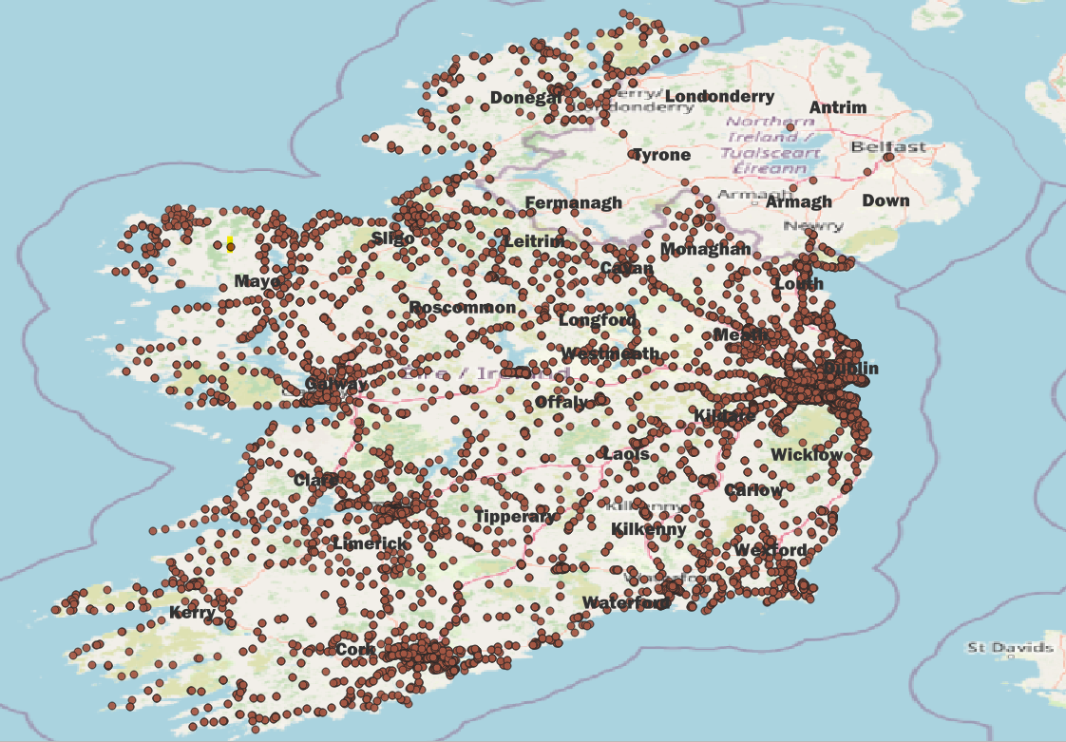
BUS STOP DISTRIBUTION IN IRELAND

Slide 5
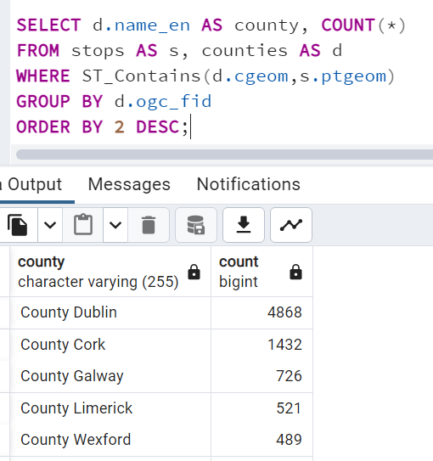
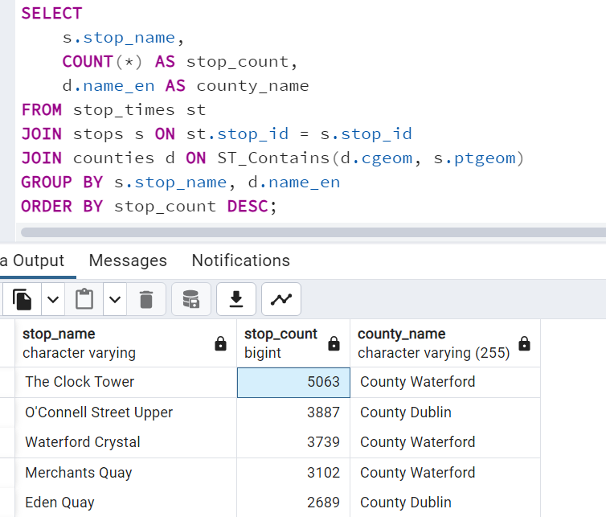
BUS HUB – CENTRES OF TRANSIT ACTIVITY
The Clock Tower at Waterford County stands out as a central hub for multiple bus routes.
Dublin County emerges as the central hotspot for public transportation, with the highest number of bus stops in the country.

Slide 6
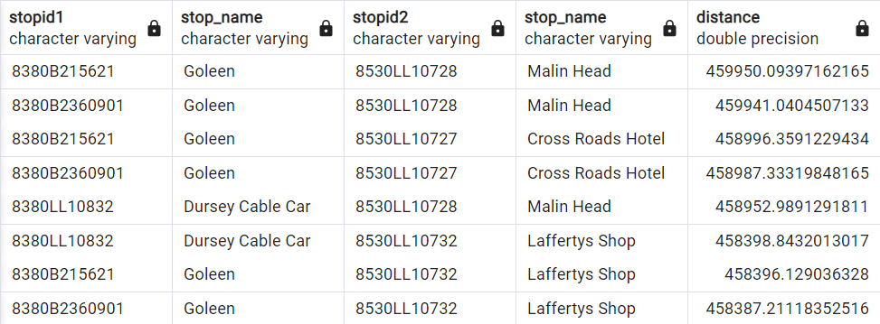
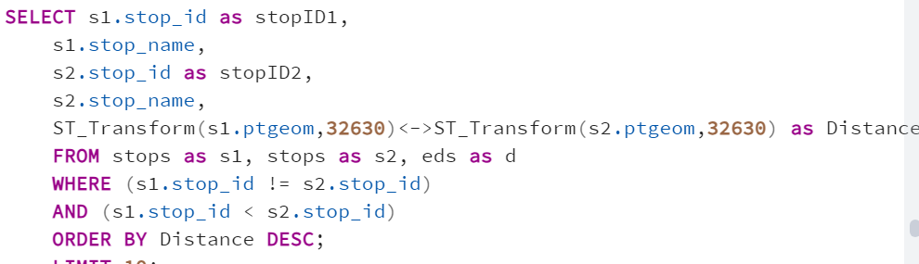
UNDERSTANDING BUS STOP DISTANCES
Bus stops between Goleen, County Cork, and Malin Head, County Donegal are among the farthest, separated by approximately 460 km.

Slide 7
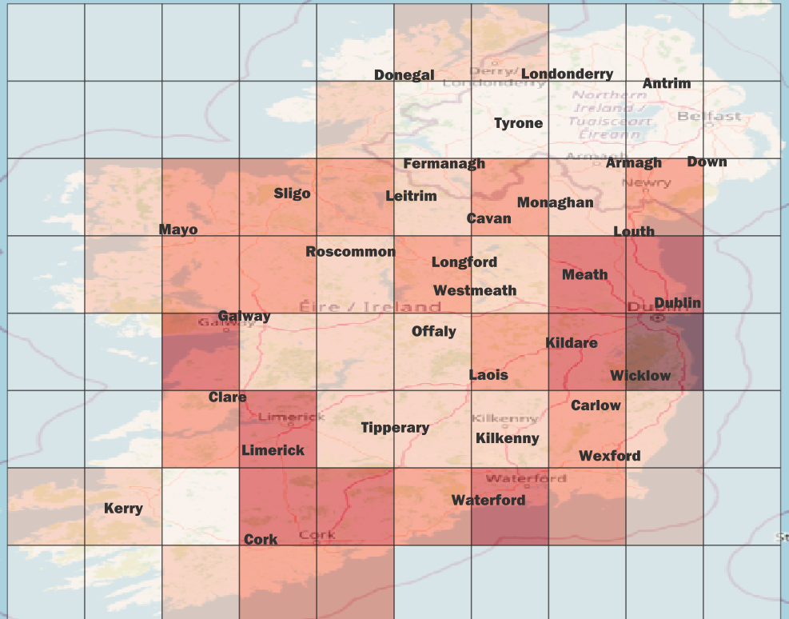
VECTOR GRID ANALYSIS
Using a uniform vector grid for precise analysis, to rule out the influence of varying polygon sizes in different counties.
Analysis reveals major urban centres such as Cork, Limerick, Dublin, Wicklow, and Kildare exhibit higher concentrations of bus stops.

Slide 8
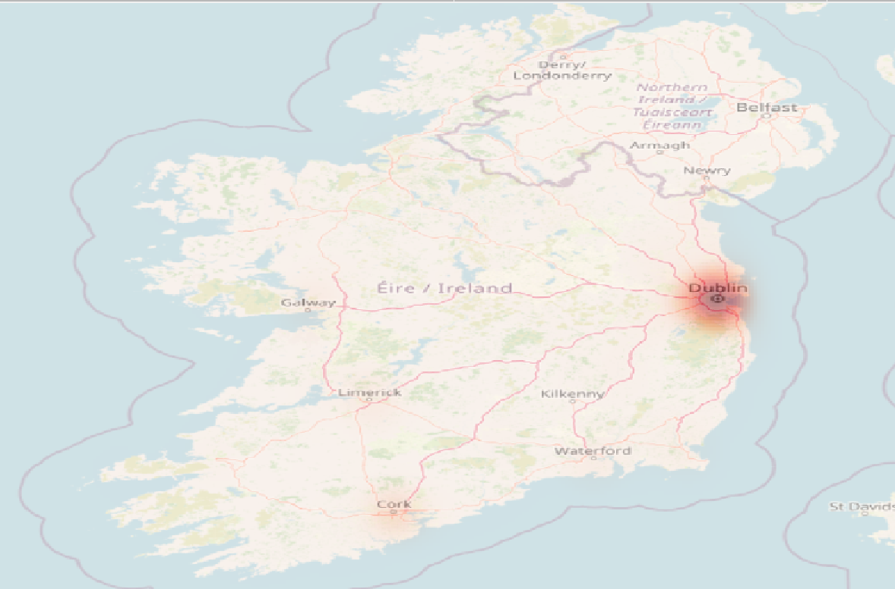
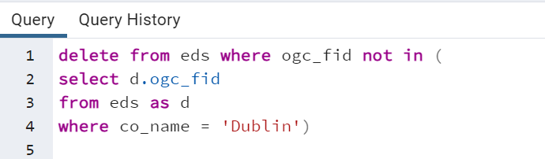
FOCUSED ANALYSIS –
DUBLIN ELECTORAL DIVISIONS
Utilizing heatmap analysis helped to get a clear understanding on the concentration spread of bus stops in Ireland.
Findings reveal a higher density of bus stops within Dublin’s electoral divisions.

Slide 9
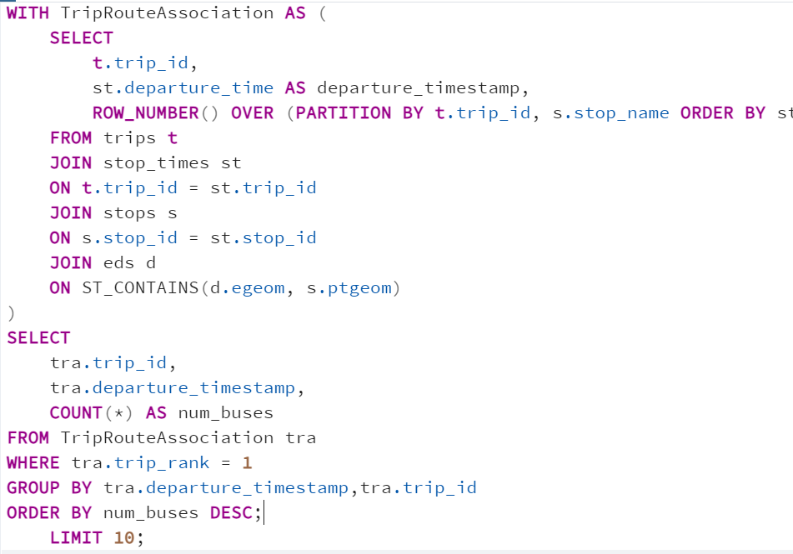
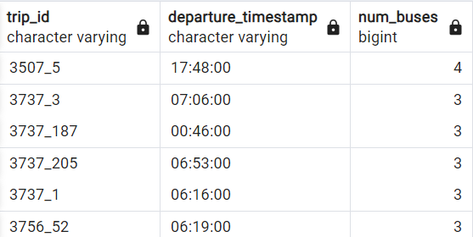
UNDERSTANDING BUS DEPARTURES PATTERNS
Findings reveal insights to help optimize schedules by identifying trips with the highest concentration of buses departing from the same stop at nearly the same time.

Slide 10
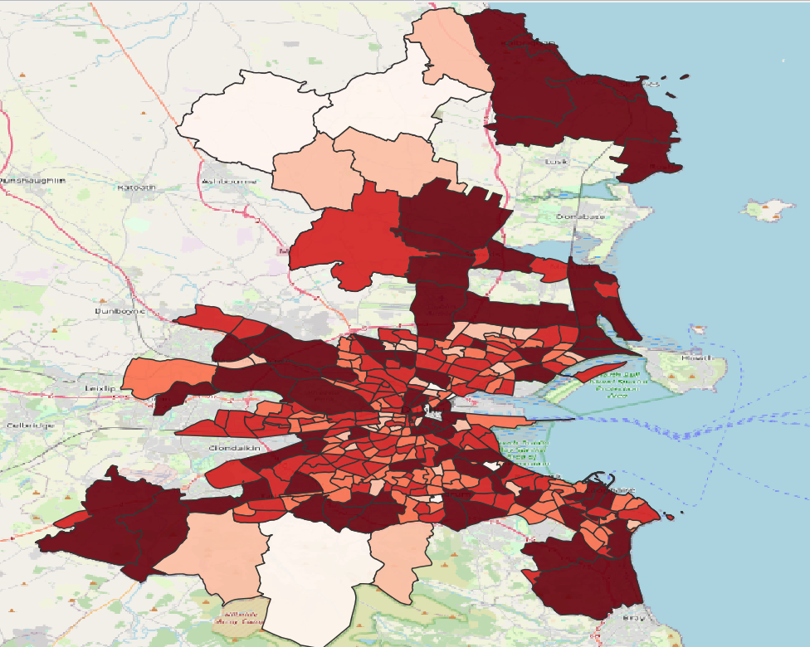
POINT IN POLYGON ANALYSIS (COUNT)
30 Electoral Divisions in Dublin have more than 100 bus stops.
146 Electoral Divisions have less than 10 bus stops.

Slide 11
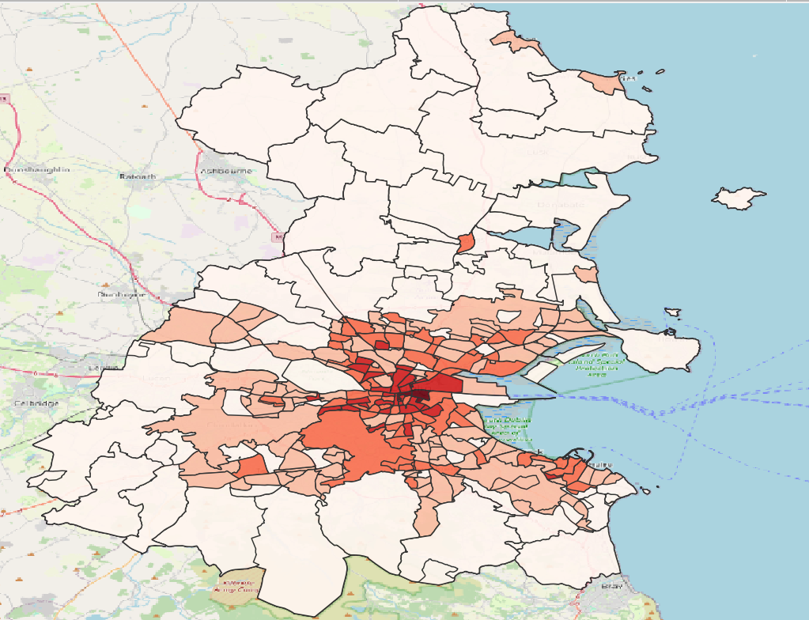
POINT IN POLYGON ANALYSIS (DENSITY)
South City Electoral Division has the highest density of bus stops per square kilometre.

Slide 12
CONCLUSION
Central Hub Identification: Clock Tower emerges as a central hub for multiple bus routes
The focus of analysis was shifted to Dublin as the bus stop concentration is higher.
Metropolitan Influence: Major urban centres have significant bus service network
Spatial Distribution: Spatial analysis provided insights into areas with greater public transportation accessibility.
Bus Frequency Patterns: Potentially identified areas with high demand or connectivity.
Can help in future transportation planning, allowing authorities to optimize bus routes, improve accessibility, and enhance efficiency of public transportation system.

Slide 13
THANK YOU

